Slide 1
Network security
Worms
Botnets
Wireless networks

Slide 2
Malware
Many different types
Classified in two ways:
How it spreads or propagates
Actions it performs on a target
Generally, broad categories are virus versus worm
For now, we’ll focus on worms, which use network propagation as a key feature
(Viruses will come later…)

Slide 3
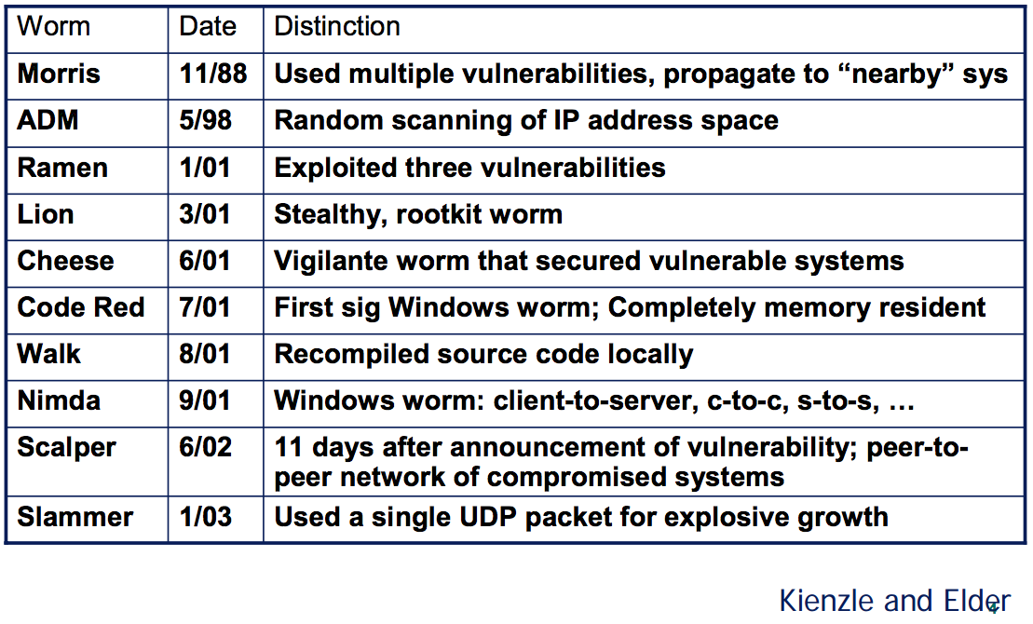
Worms: network based attacks
Tons of them!

Slide 4
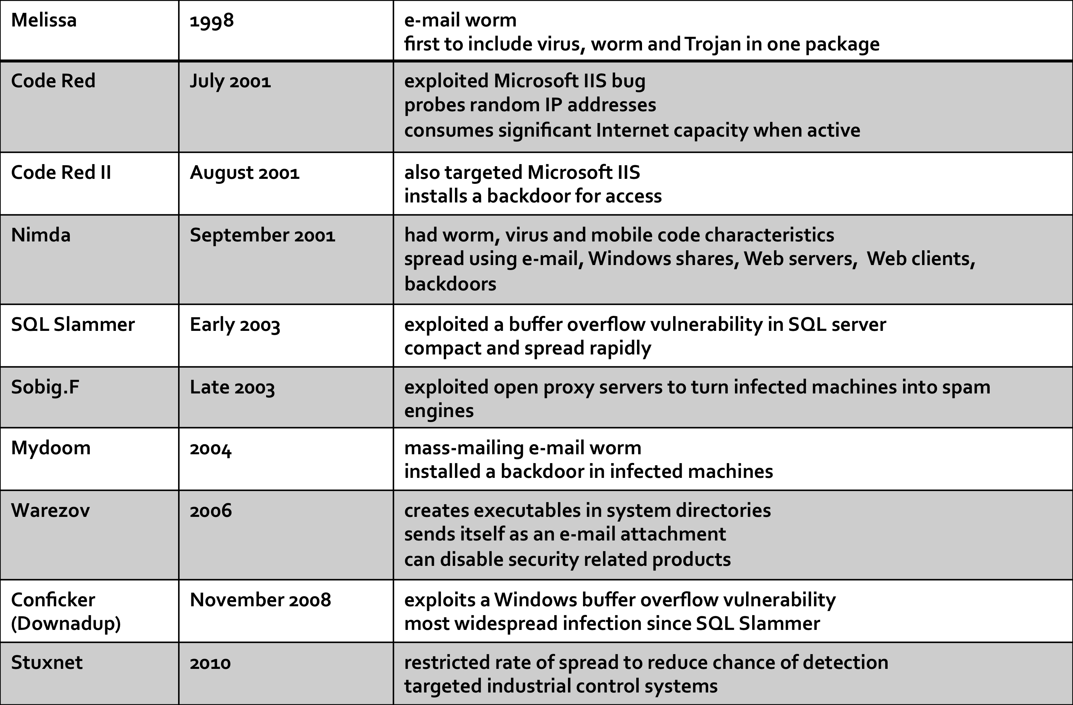
And even more of them:

Slide 5
How worms propagate
Scanning worms
Worm chooses “random” address
Coordinated scanning
Different worm instances scan different addresses
Flash worms
Assemble tree of vulnerable hosts in advance, propagate along tree
Meta-server worm
Ask server for hosts to infect (e.g., Google for “powered by phpbb”)
Topological worm:
Use information from infected hosts (web server logs, email address books, config files, SSH “known hosts”)
Contagion worm
Propagate parasitically along with normally initiated communication

Slide 6
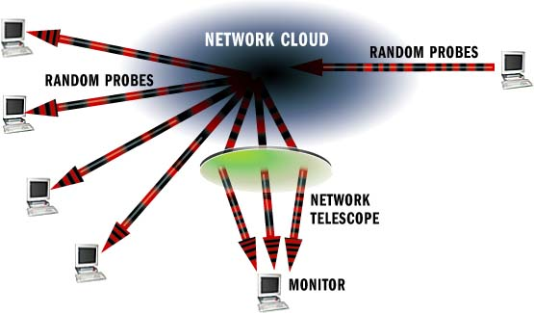
Measuring activity
Network telescopes:
Monitor a cross section of the internet address space
“Backscatter” from DOS floods
Attackers probing randomly
Scans from worms

Slide 7
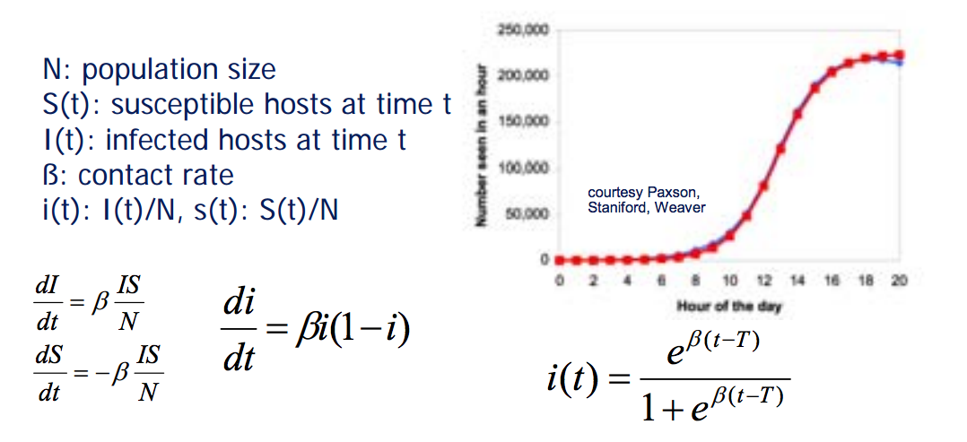
How fast are worms?
Model as an infectious epidemic

Slide 8
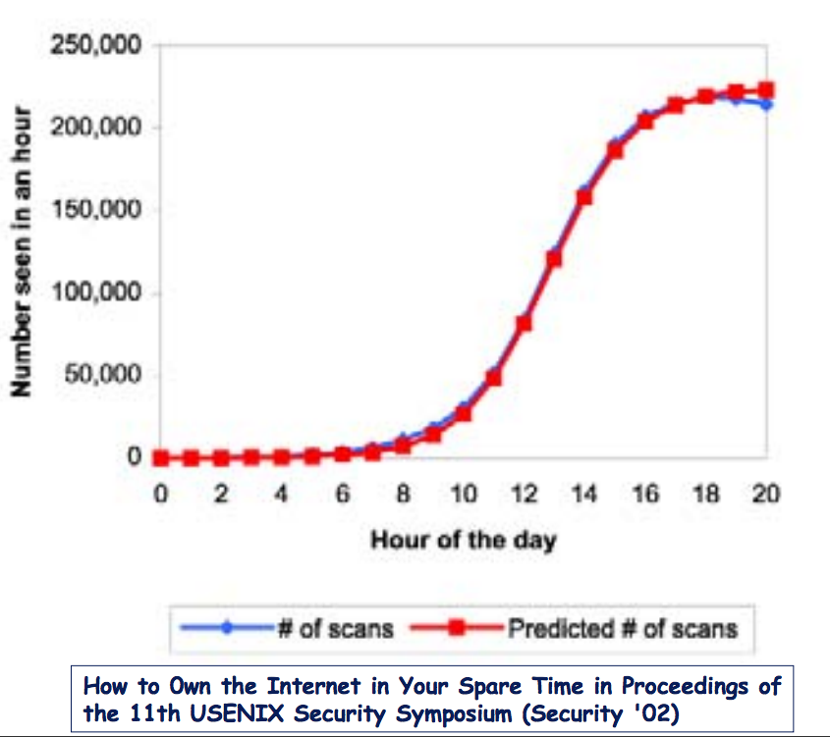
How accurate?
Code Red 1 Propagation
Count # of scans rather than number of hosts
Theory pretty close to what was observed

Slide 9
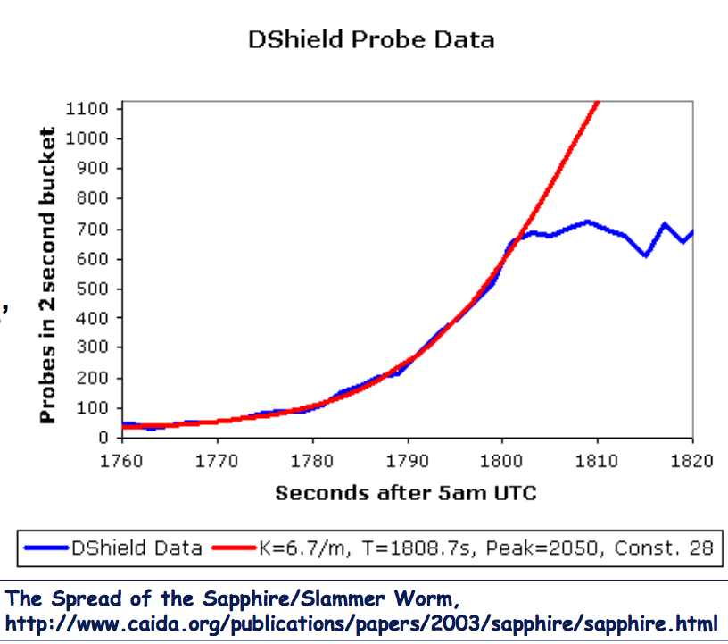
But depends on the worm
Slammer worm didn’t match theory
Fast propagating worms can encounter link bandwidth and latency constraints

Slide 10
Worm defenses
Detection of worms is via honeyfarms: collections of honeypots fed via a network telescope.
Any outbound connection will be a worm.
If telescope covers N addresses, expect detection when worm has infected 1/N of population
Detecting superspreaders
Hosts that make failed connection attempts to too many other hosts
Defense: throttling and rate limiting

Slide 11
Challenges for Worm defenses
There is a short interval between vulnerability disclosure and worm release
“zero-day” exploits are common
Worms go fast!
Slammer worm infection 90% of vulnerable hosts in 10 minutes
Large scale:
Slammer: 75,000 machines
CodeRed: 500,000 machines

Slide 12
Generic Exploit Blocking
Idea: Write a network IPS signature to detect and block all future attacks on a vulnerability
Different than writing for a specific exploit!
How:
Characterize vulnerability “shape”
Identify fields, services, or protocol states that must be present in attack traffic to exploit vulnerability
Identify data footprint size required to exploit it
Identify locality of footprint: local or spread through?
Write generic signature that can detect data that matches this “shape
This is like Shield research from Microsoft

Slide 13
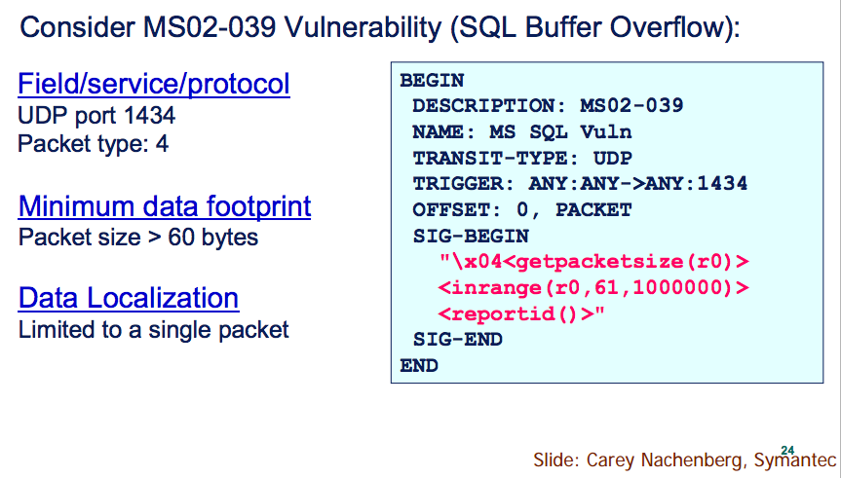
Generic exploit blocking
An example:

Slide 14
Morris Worm
Infamous (and earliest) significant worm infection
Released by Robert Morris in 1988
Goal was actually to measure the internet
Written in 99 lines of C code, it was supposed to slowly make its way across the UNIX-based VAX and SUN machines on the ~60,000 large machine internet
Instead, it brought the entire internet screeching to a halt in less than 3 days.
Estimated that it took down 10% of the internet, and cost between $100,000 and $10,000,000 before it ended.

Slide 15
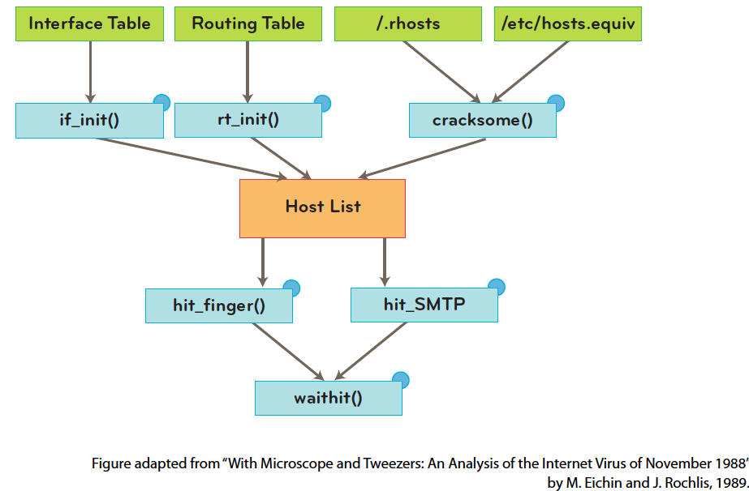
Morris worm: how?
Used 4 different attacks to propagate itself. We’ll examine a couple of them:

Slide 16
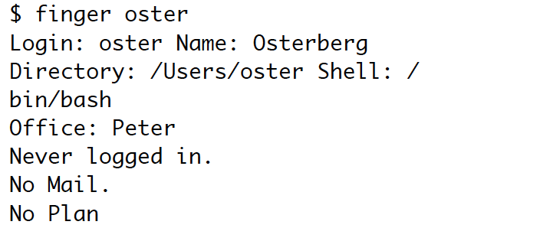
Finger
A UNIX server, used to provide information about a user at a remote host:

Slide 17
Finger weakness
Problem: Finger processes input using the C utility gets(). This function does not have bounds checking.
Essentially, this just means it doesn’t check to be sure you haven’t overrun the allocated space in the array that is set up for it.
(Remember when you ran off the end of your array in C++ in data structures? What happened?)

Slide 18
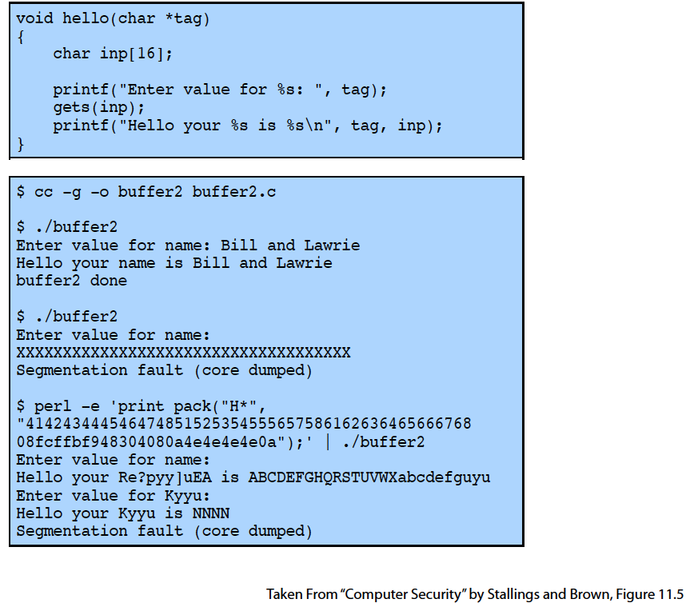
Example: gets()
C code with gets():

Slide 19
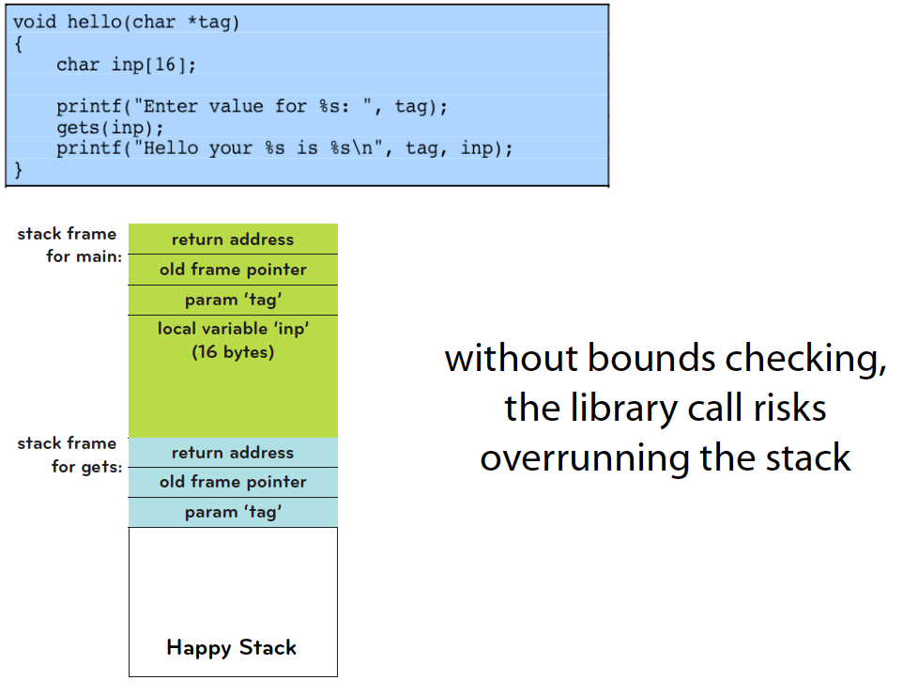
What is happening?

Slide 20
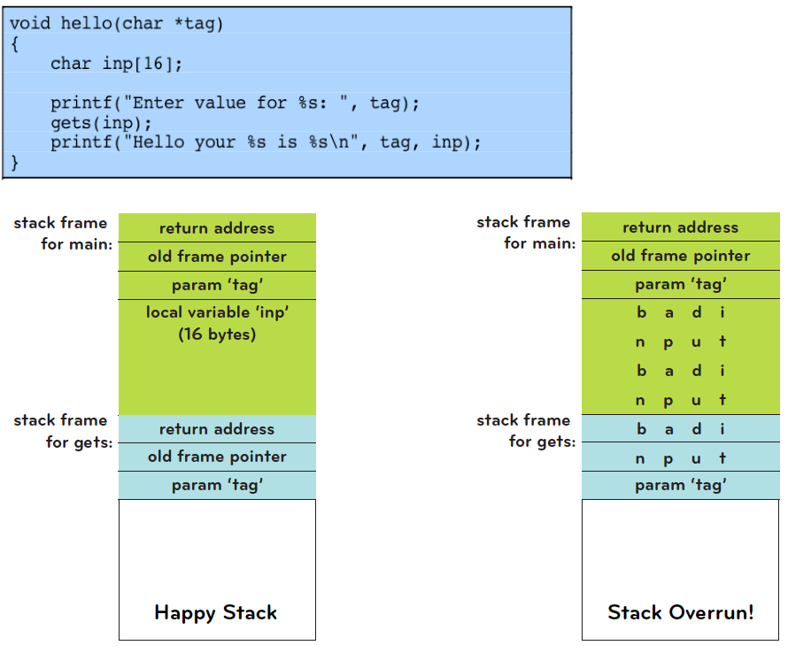
What is happening (cont)

Slide 21
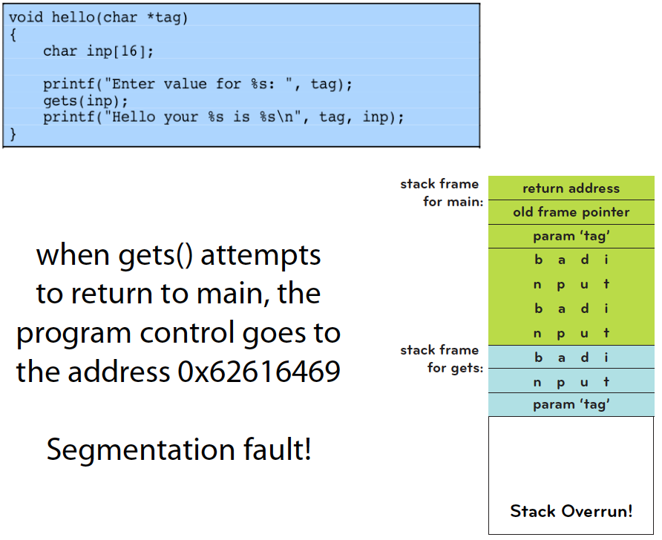
What is happening (cont)

Slide 22
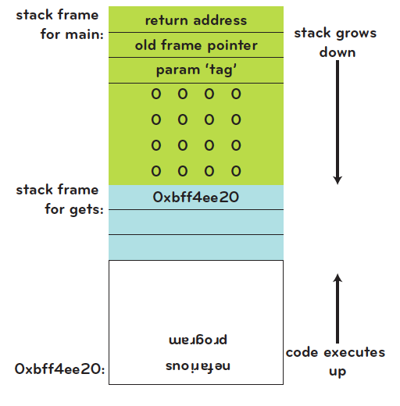
Even worse…
If one is clever, can actually execute a malicious program from the stack
This is called “smashing the stack”.
We say programs like this have “stack-based buffer overflow” problems. Unfortunately, very common in C code!

Slide 23
Back to finger
So, if someone called finger with a cleverly crafted argument, that someone could smash the stack and invoke another program
Like sh!
This is essentially one of the key components of the Morris worm.
And this is a teaser for a future lecture on buffer overflows, which we’ll look at more closely.
But first, one more vulnerability the Morris worm used to propagate…

Slide 24
Sendmail
Sendmail is a UNIX mail server
Early versions contained two “features”:
An outsider establishing an SMTP connection to the sendmail program could place sendmail in DEBUG mode
With DEBUG mode enabled, a user can execute the run command feature, which sends an email to a program. The program then uses the email as input.

Slide 25
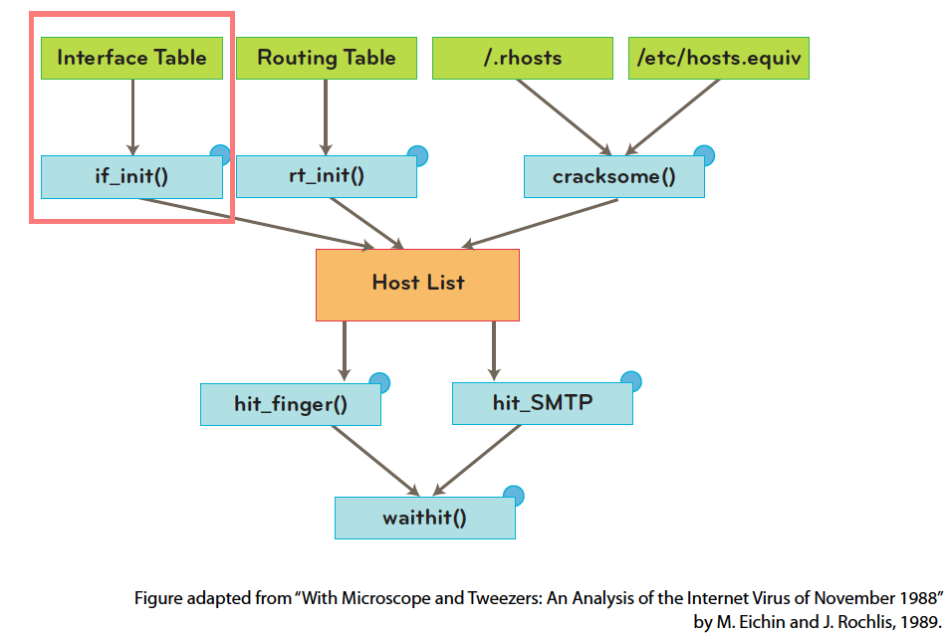
Back to the Morris worm
After initialization (and hiding itself), the worm calls if_init() routine which scans the network interfaces on that machine

Slide 26
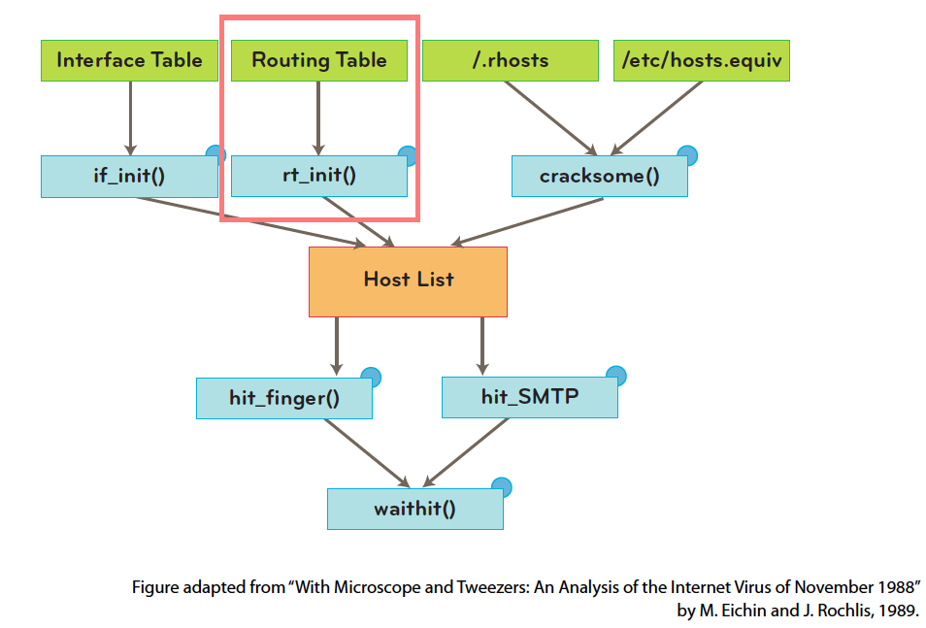
Next:
The machine then calls rt_init() to look up the machine’s routing table

Slide 27
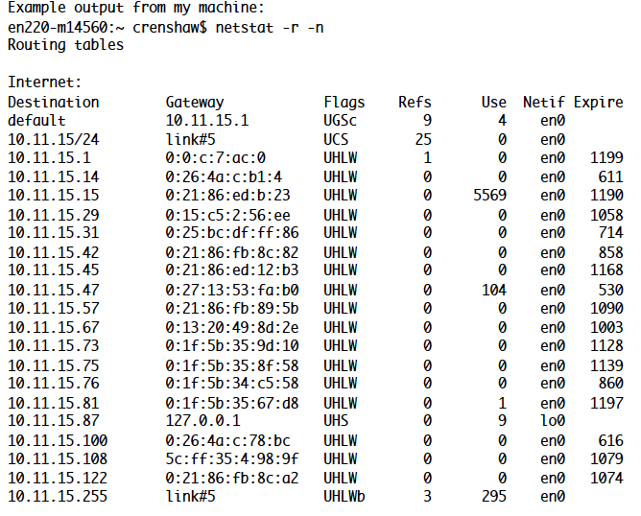
Using netstat
How? It calls netstat:
pipe=popen(“/usr/ucb/netstat –r –n”, “r”);

Slide 28
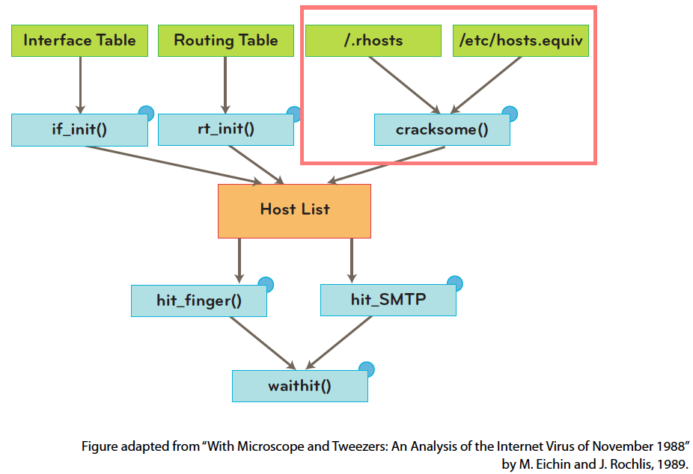
And next:
Then it calls cracksome() to find more machines that would be likely targets. (Both rhosts and rhosts.equiv list machines that the local machine knows and trusts.)

Slide 29
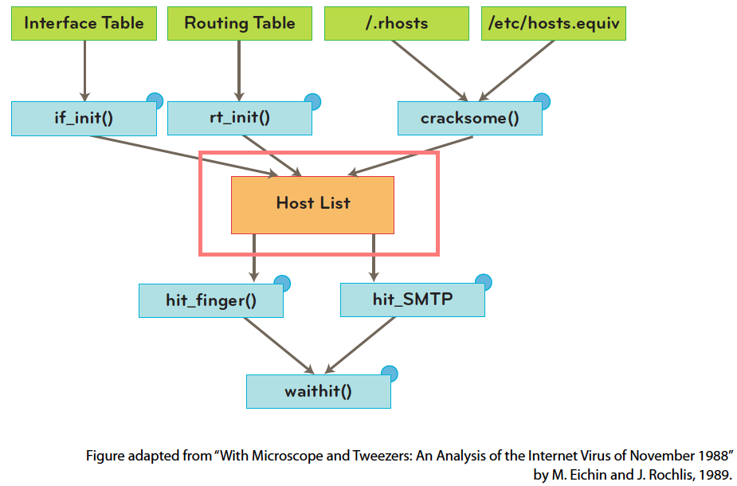
Targets are aquired
The worm now has a list of potential targets to attack.

Slide 30
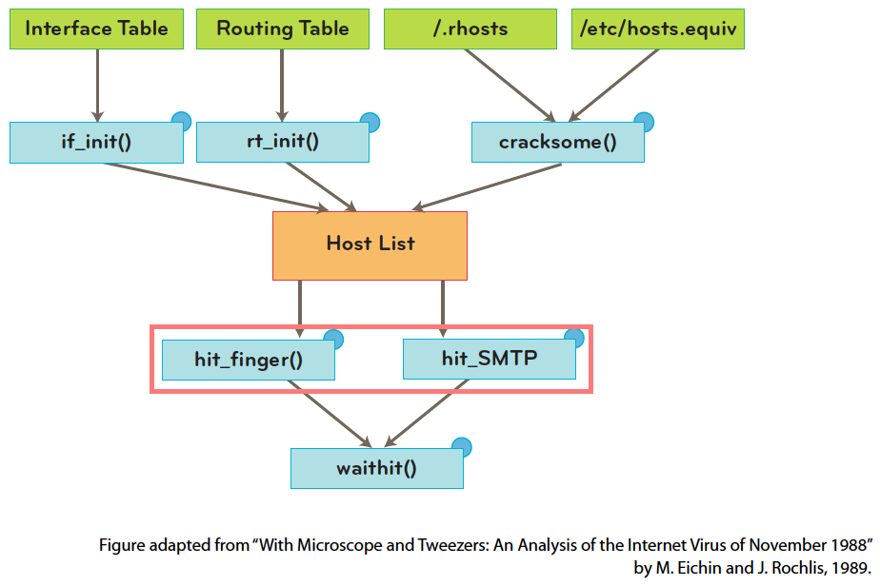
Attacking
It now tried to attack every host on this list using the finger exploit. If that fails, it tries the sendmail exploit.

Slide 31
Morris worm: next phase
Either way, a small program l1.c has hopefully been copied, compiled and launched at the remote host.
This is its “grappling hook”: a small piece of portable code that attempts to copy the full worm onto the new machine.
The final phase, waithit(), communicates with l1.c at the remote host to copy over a set of object files (the actual worm).

Slide 32
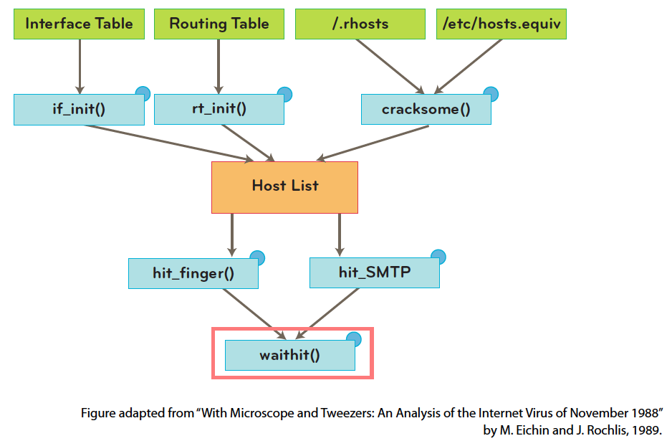
Morris worm: final phase
The object files are compiled for different targets. The program l1.c attempts to link and launch them on the target.

Slide 33
Morris worm: a mistake
You might be asking: how does this measure the internet??
Good question!
The worm was supposed to send a packet of data to 128.32.137.13, but the code had a bug. It never sent anything.
Also, the worm was supposed to detect if it was already running on the machine. However, in order to make it harder to detect later, it was set to run on the machine every 7 times. (Too much!)
Interestingly, it was released at MIT, even though Morris was a student at Cornell.

Slide 34

Morris worm: the aftermath
“Robert T. Morris was convicted of violating the Computer Fraud and Abuse Act (Title 18), and sentenced to 3 years of probation, 400 hours of community service, a fine of $10,050, and the costs of his supervision.”
He became a professor at MIT, conducting research in networks and OS.

Slide 35
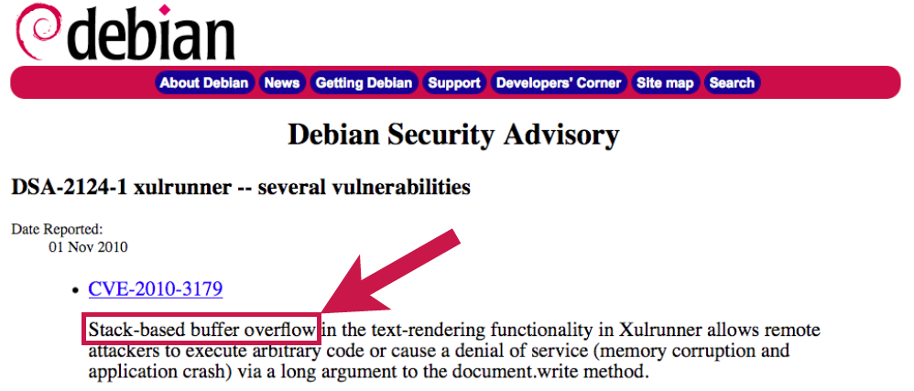
Why we care
It may seem silly to study such an old case – why should we care?
These same exploits (or similar ones) are still out there today!

Slide 36
Other Defenses
Many defenses have been enacted to stop the spread of worms. Main ones:
Firewalls
ASLR (Address Space Layout Randomization)
DEP (Data Execution Prevention) or Executable Address Space Protection
We’ll see these more later, but they are fairly strong, and there are many recent developments.

Slide 37
Botnet
Collection of compromised hosts
Spread like worms and viruses
Once installed, respond to remote commands
Platform for many network attacks
Spam forwarding
Click fraud
Keystroke logging
DDoS
Serious problems!
This is the top concern of many businesses like banks and online merchants

Slide 38
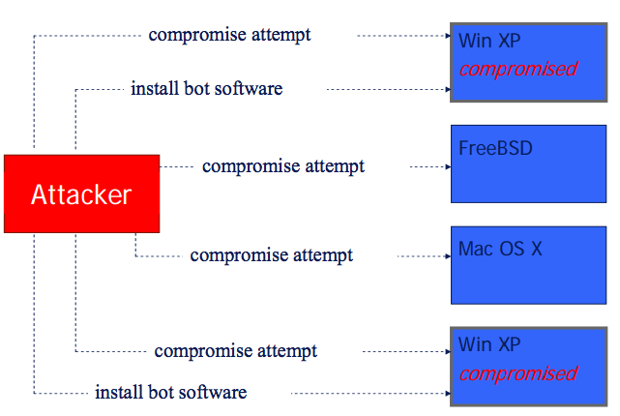
Building a botnet
Try different attacks:

Slide 39
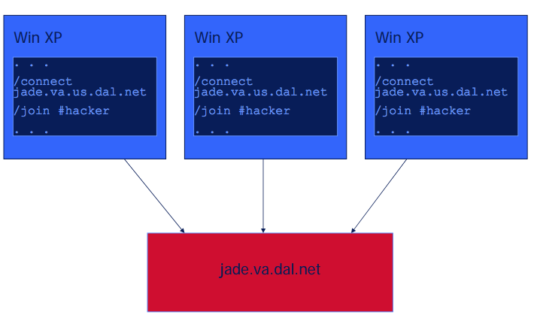
Building a botnet (cont)
Hosts then connect back:

Slide 40
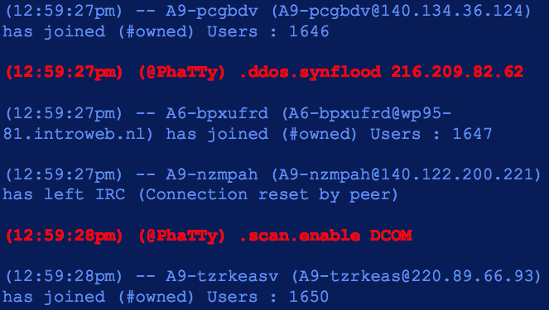
Building a botnet (cont)
And get instructions:

Slide 41
An example botnet: Storm email
Clicking on email or link caused malicious code to be installed
Fake news story on storm, ecard, links to malicious website
Incorporated a quick change to stay ahead of blocking: modified itself every 30 minutes to evade standard signature based monitoring
Infected 1.7 million bots by end of July
P2P architecture instead of centralized
For profit: it sent stock-picking spam, and ripped profits for the risen stocks

Slide 42
Bot detection methods
Signature based (and in most products)
Rule-based
Monitor outbound network connections (like ZoneAlarm) – generally annoying
Block certain ports
Hybrid approach: content based filtering
Match network packets to known command strings
Network monitoring
Bot hunter: correlate various NIDS alarms to identify infection sequence in progress
Recognize traffic patterns associated with infection

Slide 43
Wireless networking
New challenges in wireless:
Easier to sniff packets
Easier to hijack a session
Interloping: connecting through another person’s wifi connection
Authentication: physical presence can’t be assumed as a given in a LAN

Slide 44
Structure
Wifi doesn’t rely on Ethernet protocol at the link layer – instead, protocols defined by the IEEE 802.11 family of standards
Frame based, but TCP/IP reframes to packets before going higher in the stack
Management frames:
Authentication frame: client presents to an access point (AP) to identify itself
If accepted and gets reply, then presents an association request frame, at which point the access point allocates resources
At each stage, the AP replies with an association response frame if successful
Finally, disassociation frames and reassociation frames are used to leave or move between APs.

Slide 45
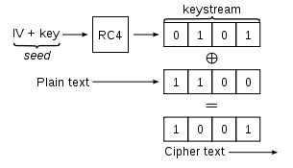
WEP
WEP protocol was built into the original 802.11 standard to address this eavesdropping.
Data frames are encrypted using a stream cipher, where ciphertext is generated via an XOR of the plaintext M and a pseudo-random binary vector.
WEP uses RC4, a stream cipher which is simple and fairly efficient.
Seed is obtained by concatenating a 24-bit initialization vector with the WEP key, a secret key that both parties share.

Slide 46
Issues in WEP
Key started small – only 64 bits (so 40 past the IV), but is now increased to 256.
The same keystream should never be reused, since an attacker can do statistical attacks.
So IV values should never be reused, but this is actually not written into the standard – access points do not reject duplicate IVs,which is a vulnerability that has been used.
WEP also does a CRC-32 checksum, which is the output of a hash function of the message. This protects only against transmission errors, though – and this has also been exploited in attacks.

Slide 47
WEP authentication methods
Open system authentication: the client does not provide credentials and can immediately associate itself to the AP.
However, must have the correct encryption key, or else the AP ignores messages.
Shared Key authentication: the client must prove its possession of the WEP key before associating.
The AP sends a plaintext challenge, who encrypts it and resends.
If it decrypts correctly, then it is allowed to associate.
Open system is actually stronger!
In shared, the message and IV are sent in the clear, so can recover the keystream.

Slide 48
Attacks on WEP
However, even open system, WEP is not secure.
The first few bytes of the RC4 keystream are strongly “non-random”, so attacks can recover information about the key using many ciphertexts.
Not fast – need 40,000 data packets to get a 50% chance of cracking it, but possible in a busy system.
ARP reinjection: Attacker in an open system can assocate, capture a single ARP packet, and resend repeatedly, which generates the necessary amount of traffic quite quickly.

Slide 49
WEP Chop-chop attack
Another attack uses the CRC-32 checksum.
If checksum is incorrect, packet is silently dropped.
Attacker truncates data in the packet by one byte, then corrects checksum by guessing the byte = X.
If x was correct, it will respond.
Enough guesses and the entire keystream is recovered, at which point an ARP packet can be forged, ecrypted with this keystream, and sent in.

Slide 50
WEP caffe latte attack
Commonly used in coffee shops.
Attacker listens to wifi traffic and identifying APs that clients are trying to connect to, and then sets up a honeypot network with the same SSID.
The AP is never questioned in the protocol, so the honeypot takes some initial ARP packets from a client, and then flips bits referring to the sender MAC and IP and does a chop-chop attack.
This results in a valid encrypted ARP to the client, which can be repeatedly sent until enough information is gathered for the WEP key to be broken.
Note: This can be done to break an organization’s key while no where near the AP!

Slide 51
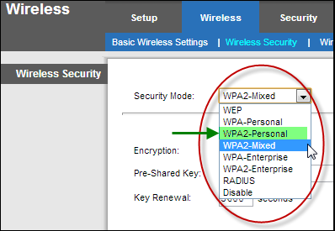
WPA: Wi-Fi Protected Access
More complex authentication scheme:
First generates a shared key for use in generating encryption keys
Then client is authenticated to the AP
Then shared key is used with encryption algorithm to generate keystreams
Two modes: PSK (or personal) and WPA Enterprise
Two protocols for encryption traffic: TKIP and WPA2

Slide 52
WPA PSK or personal
A shared secret key is manually entered into an AP and the client
Weak passwords can be a huge problem here: initial 4 way handshake can be captured and then broken via a dictionary attack
Not really a weakness of the protocol – just a reminder to be careful of passwords!

Slide 53
WPA 802.1x mode, or Enterprise
A third party authentication service is responsible for authenticating client and generating the key.
Several possibilities, governed by the Extensible Authentication Protocol, or EAP
Considered fairly secure

Slide 54
WPA: TKIP versus WPA2
TKIP, or Temporal Key Integrity Protocol, uses the same RC4 that is a problem in WEP
However, stronger implementation: increases the IV length and incorporates a “key-mixing” algorithm, so not simply concatenating
Still potentially vulnerable, but much more secure
WPA2 is based on AES, which (as of now) has not been broken.
Variations of the chop-chop attack have been performed on TKIP, but WPA has better safeguards, so again much more difficult.

